Slide 1
Principles of Curriculum Design … in STEM Education
Merrilyn Goos
University of Limerick

Slide 2
Outline
Understanding STEM education
Curriculum design components
Three models for organising curriculum:
Disciplinary process driven
Cross-curricular competencies
Integrated curriculum

Slide 3
What is “STEM” education?
Increasing levels of integration: Which level applies in your context?
Form of integration | Features
1. Disciplinary | Concepts and skills are learned separately in each discipline.
2. Multidisciplinary | Concepts and skills are learned separately in each discipline but within a common theme.
3. Interdisciplinary | Closely linked concepts and skills are learned from two or more disciplines with the aim of deepening knowledge and skills.
4. Transdisciplinary | Knowledge and skills learned from two or more disciplines are applied to real-world problems and projects, thus helping to shape the learning experience.

Slide 4
STEM and 21st century skills
Dimensions of 21st century skills: To what extent are these evident in your country’s curriculum?
Dimensions | Examples
Cognitive | Knowledge domains, problem solving, critical thinking, reasoning, creativity
Intrapersonal | Values, ethics, self-management
Interpersonal | Teamwork, communication, leadership
Notes:
Countries that wish to improve student performance in the STEM disciplines are looking to their curricula to ensure there is a focus on both discipline knowledge and interpersonal, social and ethical values.
There are many lists of C21 skills – here is a summary.

Slide 5
EPI*STEM’s focus in STEM education
Strengthen learning and teaching in the separate STEM disciplines
Develop problem solving skills and productive habits of mind
Explore connections between disciplines

Slide 6
What is a “curriculum”?
A curriculum is an attempt to communicate the essential principles and features of an educational proposal in such a form that it is open to critical scrutiny and capable of effective translation into practice’ (Stenhouse, 1975, p. 4).
Intended curriculum: vision laid out by curriculum designers
Implemented curriculum: teachers’ interpretation of formal written documents and the way they enact this in the classroom
Attained curriculum: learning experiences as perceived by students and what students actually learn

Slide 7
Curriculum design components
Rationale: What educational purposes and principles underpin the curriculum?
Aims and objectives: Towards which specific learning goals are students working?
Content: What are students learning and how is this sequenced?
Learning activities: How are students learning?
Teacher role: How is the teacher facilitating learning?

Slide 8
Curriculum design components (continued)
Materials and resources: With what are students learning?
Grouping: How are students allocated to various learning pathways and how are they organised for learning within the classroom?
Location: What are the social and physical characteristics of the learning environment?
Time: How much time is available for specific topics and learning tasks?
Assessment: How shall we know how far has learning progressed?

Slide 9
Curriculum design components
To what extent are these curriculum design components evident in your own curriculum document(s)?
Rationale | Materials and resources
Aims and objectives | Grouping of students
Content | Location/learning environment
Learning activities | Time
Teacher role | Assessment

Slide 10
Curriculum driven by disciplinary processes
A process-driven curriculum emphasises the “thinking and doing” of the discipline as well as its content.
Example: In mathematics education, process-driven school curricula emphasise problem solving, investigation, applications and modelling.
But there is an inevitable tension between representing the content and processes of a discipline.

Slide 11
The tension between mathematical content and mathematical process
How to represent the relationship between mathematical content and mathematical process?
Australian junior secondary school mathematics curriculum (1990s)
Number | Algebra | Space | Measurement | Chance & data
Working Mathematically
Investigating, Conjecturing, Using problem solving strategies, Applying and verifying, Using mathematical language, Working in context
Notes:
Other State based curricula provided a general statement of what this process meant and tried to embed “Working mathematically” into the mathematical content strands. The drawback of this approach is that WM can become rather invisible, and without clear guidelines teachers could overlook these mathematical processes and their relationship with mathematical content.
So there are difficulties in both approaches, and this foreshadowed one of the tensions I want to analyse, namely the relationship between the mathematical content and mathematical proficiency (process) strands in the Australian Curriculum: Mathematics.

Slide 12
Mathematical process as “proficiency”
In the US “Adding it up” report, mathematical proficiency is conceptualised as a single entity comprising interdependent strands.
Notes:
I mentioned earlier that the Australian Curriculum: Mathematics adapted the five strands of mathematical proficiency from the US “Adding it up” report.
In this report, mathematical proficiency is conceptualised as a single entity comprising interdependent strands.

Slide 13
Cross-curricular competencies: Australian curriculum

Slide 14
Cross-curricular competencies: Irish curriculum

Slide 15
Integrated curriculum

Slide 16
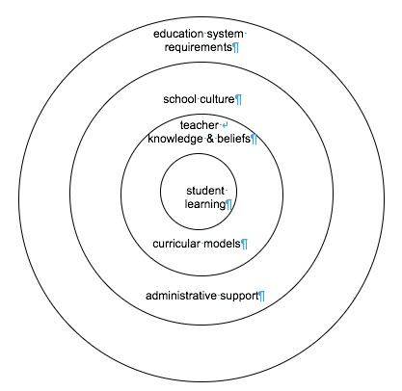
Barriers to curriculum integration

